Slide 1
Division of Family Medicine Bella Vista Hospital Mayagüez, Puerto Rico
Kocuria infections: A case series
Authors:
- Francisco Gutierrez M.D. (Family Medicine Specialist)
- Dilianys Jimenez M.D. (PGY-3 Resident Family Medicine)
- Semjon Tsyrlin M.D. (PGY-3 Resident Family Medicine)
- Jose Medrano M.D. (PGY-2 Resident Family Medicine)

Slide 2
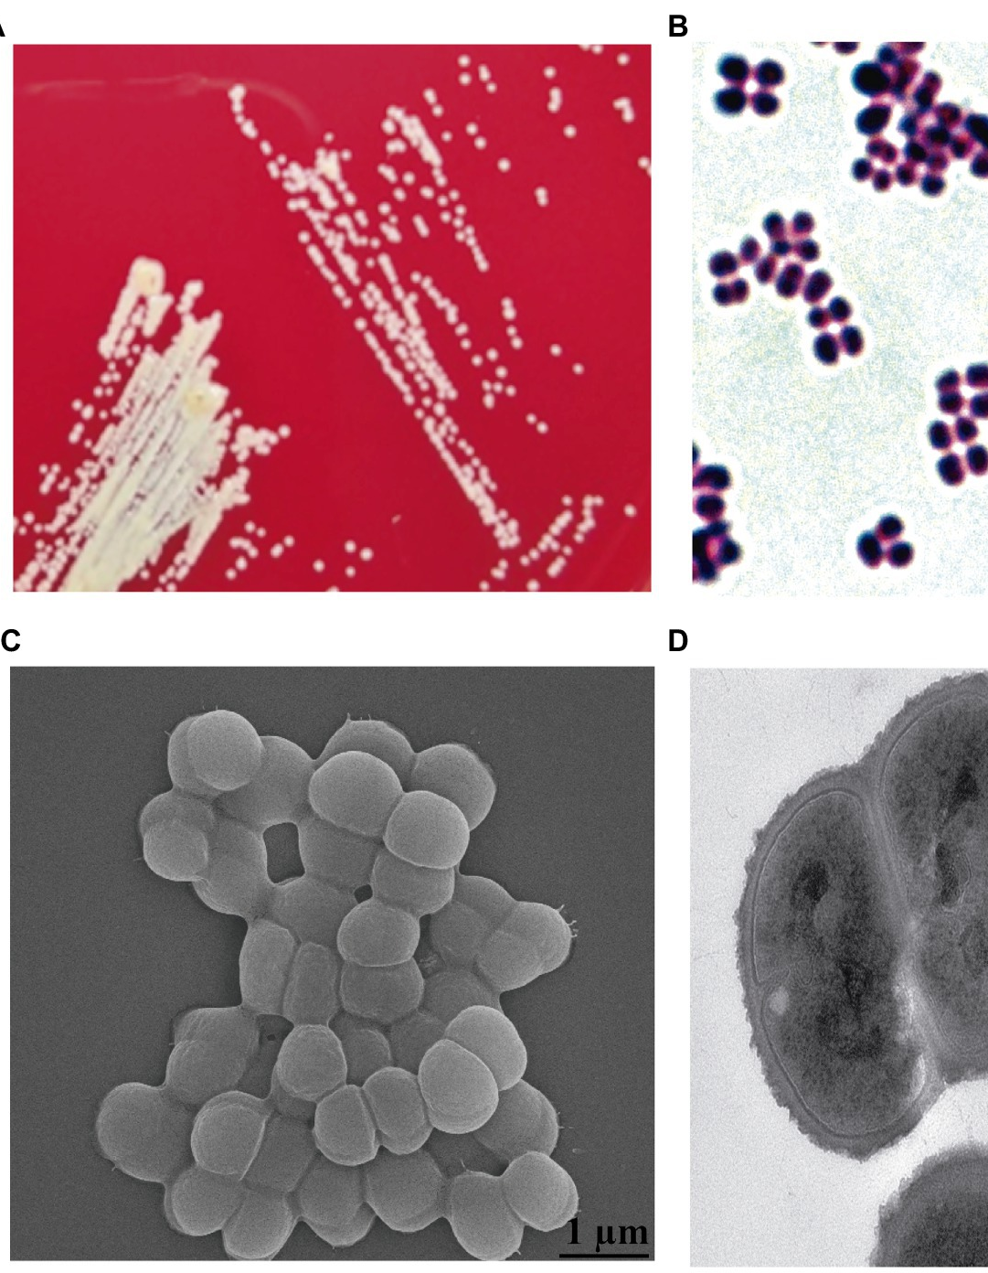
The consequential Kocuria, is an institutional level, observational retrospective study of an emerging cause of infection.
The purpose of this study is to describe at characterize the patients admitted in our institutions with culture studies positive for Kocuria Kristniae (KK).
KK is a gram-positive, strictly aerobic, catalase-positive, coagulase-negative, non-haemolytic coccus that is non-encapsulated, and non-endospore-forming, and is increasingly emerging as a pathogen implicated in human disease.
While there have been case reports throughout the world in diverse patient populations of disease caused by this bacteria, a thorough literature review failed to encounter a study evaluating multiple cases of infection by KK within a single institution.
The investigators seek to employ observational methods in this pilot study to describe the cases encountered in our institution in order to better characterize the patients susceptible to such infection, and to generate more focused research into this emergent pathogen.

Slide 3
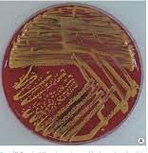
METHODS
While observing all HIPAA and institutional privacy protocols, in compliance with all rules and conditions set forth by the IRB, a record review was conducted of all patients admitted in Bella Vista Hospital (BVH) in Mayaguez, Puerto Rico between the dates of 4/1/21 until 6/1/22.
All patients who were over 18 y/o and inpatient at BVH whose record demonstrated a culture study positive for KK were included in the analysis.
The investigators manually reviewed the selected medical records. Variables extracted from the records included: demographics, acute and chronic illness diagnoses, relevant surgical history including placement of prosthetic devices, and antibiotic treatment offered during their admission.
The data were analyzed and tabulated using descriptive statistics to generate patterns of clinical interest that may inspire further inquiry.

Slide 4
Distribution by sex (n=14)
In the stated EMR search period 14 patient records fit the inclusion criteria of having had a culture study positive for Kocuria Kristinae (KK), with 6 females and 8 males.

Slide 5
Distribution by age groups.
The mean age of the study group was 69.3 years (Median = 75.5; SD = 17.5; Range = 26, 90). The age distribution was negatively skewed due to the presence of a 26-year-old subject.

Slide 6
Distribution of patients by presumptive diagnosis on admission
DIAGNOSIS ON ADMISSION | NUMBER | PERCENT
Abdominal pain | 1 | 7.1 %
Abdominal wall abscess | 1 | 7.1 %
Foot abscess | 1 | 7.1 %
Back abscess | 1 | 7.1 %
Bullous pemphigoid | 1 | 7.1 %
Decubitus ulcer right hip | 1 | 7.1 %
Dehydration | 1 | 7.1 %
Enteritis | 1 | 7.1 %
Food intolerance | 1 | 7.1 %
Infected knee prosthesis | 1 | 7.1 %
Left foot ulcer | 1 | 7.1 %
Left toe ulcer | 1 | 7.1 %
Osteomyelitis | 1 | 7.1 %
Sepsis | 1 | 7.1 %
TOTAL | 14 | 100 %
All 14 subjects had different primary admission diagnoses, although if analyzed in a more generalized fashion, 64% of patients had definite infectious primary diagnoses (abscesses, infected ulcers, osteomyelitis, infected knee prosthesis, and sepsis), 14% had possible infectious primary diagnoses (abdominal pain, enteritis), and for 22% infection wasn’t the primary reason of admission (dehydration, bullous pemphigoid, food intolerance).

Slide 7
Prevalence of medical conditions.
ASSOCIATED MEDICAL CONDITIONS | NUMBER | PERCENT
History of cancer | 2 | 14.3 %
Active prostate cancer | 1 | 7.1 %
Active Non-Hodgkin’s lymphoma | 1 | 7.1 %
Diabetes mellitus | 8 | 57.1 %
GFR < 50 non ESRD | 7 | 50 %
ESRD on HD | 2 | 14.3 %
Bedridden | 3 | 21.4 %
Presence of venous central line | 0 | 0 %
Associated positive MRSA | 3 | 21.4 %
Infected knee prosthesis | 1 | 7.1 %
Foley condom | 1 | 7.1 %
Foley catheter | 2 | 14.3 %
It was noted that 57.1% of patients with KK positive cultures had diabetes, 50% had CKD with GFR <50, 21.4% were bedridden, 14.3% were active cancer patients (one with Hodgkin’s lymphoma, one with prostate CA), and 7.1% (1 patient) was currently receiving corticosteroid therapy.
These were not mutually exclusive, because some patients were in multiple co-morbidity categories.
22% of patients did not belong to any of the immunocompromising categories selected above.

Slide 8
Results of type of culture for Kocuria.
2 patients had positive urine culture for KK, and there were 4 patients with KK positive blood cultures.
For patients with KK in abscesses, they were located on the abdomen, back, and right foot.
For patients with bone cultures positive for KK, they were drawn from a foot, a left toe, and from the right knee.
Infected ulcers with KK occurred on the left hand and the right foot.

Slide 9
Patients on antibiotics when collecting cultures.
Prevalence of antibiotics used.
ANTIBIOTICS USED | NUMBER | PERCENT
Aztreonam | 1 | 7.1 %
Ceftriaxone | 3 | 21.4 %
Gentamicin | 1 | 7.1 %
Clindamycin | 4 | 28.6 %
Ciprofloxacin | 3 | 21.4 %
Vancomycin | 5 | 35.7 %
Metronidazole | 2 | 14.3 %
Ampicillin | 1 | 7.1 %
Piperacillin/Tazobactam | 5 | 35.7 %

Slide 10
After evaluation of data noticed that most of the patients were already on antibiotics in the moment of culture samples collection which did not affect the detection of KK.
On notice almost half of the patients were on single or doble scheme of antibiotics, small number of the patients were on 3 o 4 combined antibiotics.
There were no lethal outcomes during the 14 admissions examined.

Slide 11
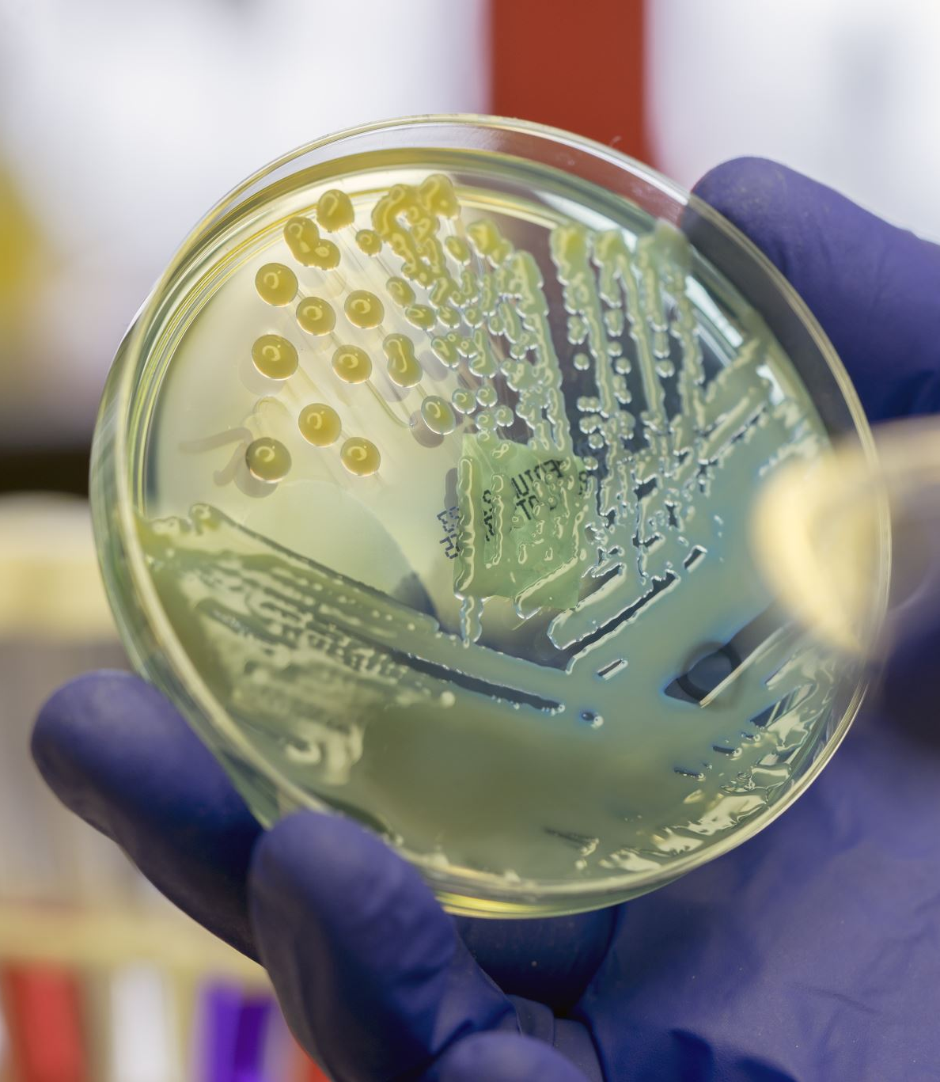
Conclusions
Patient in our cohort tended to be older and infection occurred in a wide variety of body sites, the body site included both natural and prosthetic.
Three individual with KK infection were immunocompetent, providing evidence that it would be virulent and not merely be ignored as opportunistic, or contaminant.

Slide 12
References
sensitivity and clinical impact of members of the genus Kocuria. J Med Microbiol. 2010 Dec;59(Pt 12):1395-1402.
Ahmed NH, Biswal I, Roy P, Grover RK. Kocuria kristinae, an unusual pathogen causing opportunistic infections in patients with malignancy. Indian J Med Microbiol. 2014 Oct-Dec;32(4):456-8.
Kolikonda MK, Jayakumar P, Sriramula S, Lippmann S. Kocuria kristinae infection during adalimumab treatment. Postgrad Med. 2017 Mar;129(2):296-298.
Napolitani M, Troiano G, Bedogni C, Messina G, Nante N. Kocuria kristinae: an emerging pathogen in medical practice. J Med Microbiol. 2019 Nov;68(11):1596-1603
Chen HM, Chi H, Chiu NC, Huang FY. Kocuria kristinae: a true pathogen in pediatric patients. J Microbiol Immunol Infect. 2015 Feb;48(1):80-4.
Hassan, R., Bassiouny, D. and Matar, Y., 2016. Bacteremia Caused by Kocuria kristinae from Egypt: Are There More? A Case Report and Review of the Literature. Case Reports in Infectious Diseases, 2016, pp.1-4.
Tewari R, Dudeja M, Das AK, Nandy S. Kocuria kristinae in catheter associated urinary tract infection: a case report. J Clin Diagn Res. 2013 Aug;7(8):1692-3
Dunn R, Bares S, David MZ. Central venous catheter-related bacteremia caused by Kocuria kristinae: case report and review of the literature. Ann Clin Microbiol Antimicrob. 2011 Aug 24;10:31
Iyer PG, Ashkenazy N, Weiss SJ, Miller D, Flynn HW Jr. Endophthalmitis Caused by Kocuria Kristinae. Case Rep Ophthalmol. 2022 May 31;13(2):408-413.
Živković Zarić RS, Pejčić AV, Janković SM, Kostić MJ, Milosavljević MN, Milosavljević MJ, Opančina VD. Antimicrobial treatment of Kocuria kristinae invasive infections: Systematic review. J Chemother. 2019 May;31(3):109-119
Paharik AE, Horswill AR. The Staphylococcal Biofilm: Adhesins, Regulation, and Host Response. Microbiol Spectr. 2016
R. Ben-Ami, S. Navon-Venezia, D. Schwartz, Y. Schlezinger, Y. Mekuzas, and Y. Carmeli. Erroneous Reporting of Coagulase-Negative Staphylococci as Kocuria spp. by the Vitek 2 System. Journal of Clinical Microbiology, Mar. 2005, Vol 43, No. 3, p. 1448–1450
CDC Opportunistic Infections definition. Available at: https://www.cdc.gov/hiv/basics/livingwithhiv/opportunisticinfec-tions.html

